Slide 1
ClaSP – Time Series Segmentation CIKM2021, 1-5 November 2021, Online
Patrick Schäfer, Arik Ermshaus, Ulf Leser

Slide 2
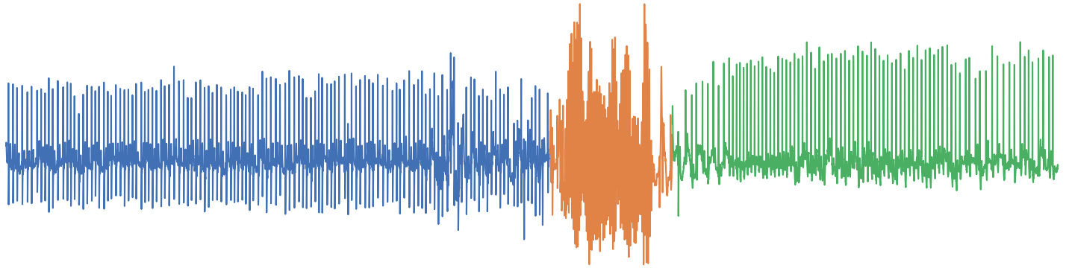
Time Series
A time series is a temporally-ordered sequence of real values
Electrocardiography (ECG) data [1]
time
2

Slide 3
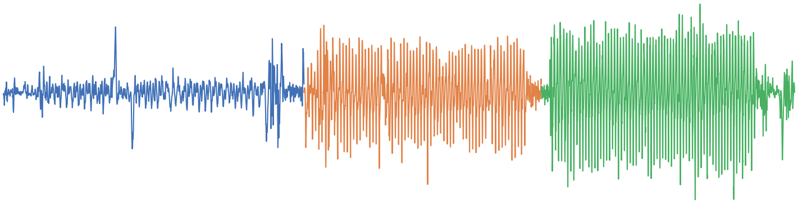
Biological and Physical Processes
The study of biological and physical processes results in long time series
Changes in internal state result in observable changes of measurements
The data is unlabelled
premature ventricular contractions
normal heart
beats
bundle branch block beats
ECG data [1]
walk
jog
run
Motion Data [2]

Slide 4
Time Series Segmentation
Task: Find a meaningful segmentation given the assumption that segments correspond to changes in an underlying process
Segment 2
Observable change
Observable change
Segment 1
Segment 3
4

Slide 5
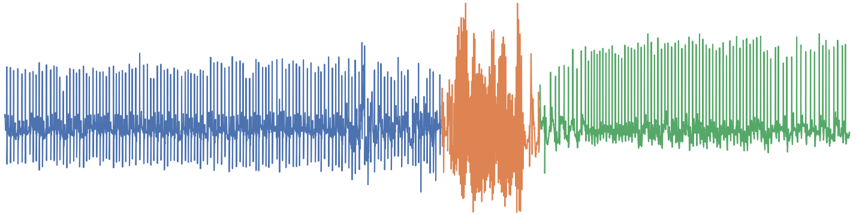
Observation: Self-Similarity
similar
similar
Different segments have distinguishable statistical properties
similar

Slide 6
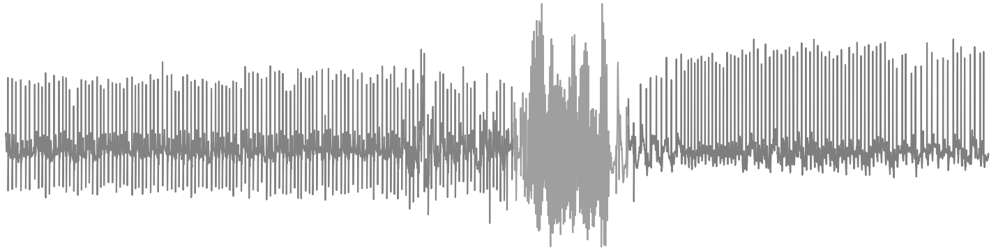
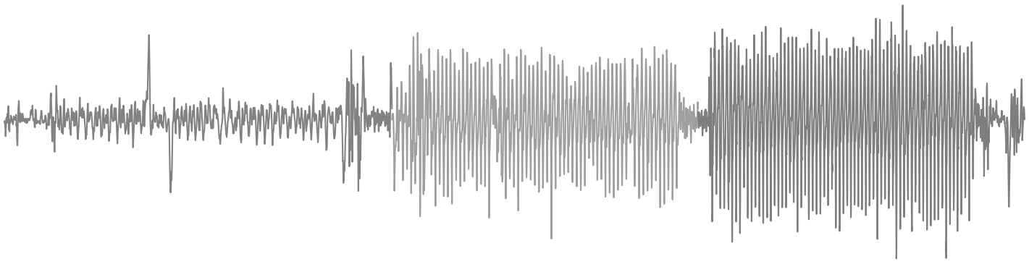
Supervised Algorithms but unlabelled Data
Literature provides a rich pool of supervised algorithms
Trained on labelled data
Learn some statistical property
Unfortunately, the time series are unlabelled
Our Solution: Train a classifier on self-supervised data
6

Slide 7
Approach: Self Supervision & Classification
1. Time Series
2. Extract
Subsequences of length w
...
...
...

Slide 8
Approach: Self Supervision & Classification
2. Extract
Subsequences
...
...
...
3. Iterate hypothetical split
1. split
4. Assign Labels Y={0,1}
y_{true}
0 1
1 1
Left 0 1 Right

Slide 9
Approach: Self Supervision & Classification
2. Extract
Subsequences
...
...
...
3. Iterate hypothetical split
1. split
2. split
4. Assign Labels Y={0,1}
y_{true}
0 1
1 1
y_{true}
0 0
1 1
Left 0 1 Right

Slide 10
Approach: Self Supervision & Classification
2. Extract
Subsequences
...
...
...
3. Iterate hypothetical split
1. split
2. split
3. split
4. Assign Labels Y={0,1}
y_{true}
0 1
1 1
y_{true}
0 0
1 1
y_{true}
0 0
0 1
Left 0 1 Right

Slide 11
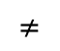
Approach: Self Supervision & Classification
...
...
...
...
3. Iterate hypothetical split
1. split
4. Assign Labels Y={0,1}
y_{true}
0 1
1 1
=
$$≠$$
=
=
5. Train & Validate a Classifier
y_{pred}
0 0
1 1
First two samples have similar statistical properties thus classifier confuses these
Score=3/4=75%

Slide 12
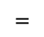
Pipeline: Self Supervision
...
...
...
...
3. Iterate hypothetical split
2. split
4. Assign Labels Y={0,1}
y_{true}
0 0
1 1
=
$$=$$
=
=
5. Train & Validate a Classifier
y_{pred}
0 0
1 1
Classifier is correct
Score=4/4=100%

Slide 13
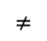
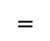
Pipeline: Self Supervision
...
...
...
...
3. Iterate hypothetical split
3. split
4. Assign Labels Y={0,1}
y_{true}
0 0
0 1
=
$$=$$
$$≠$$
=
5. Train & Validate a Classifier
y_{pred}
0 0
1 1
Classifier confuses last two samples
Score=3/4=75%

Slide 14
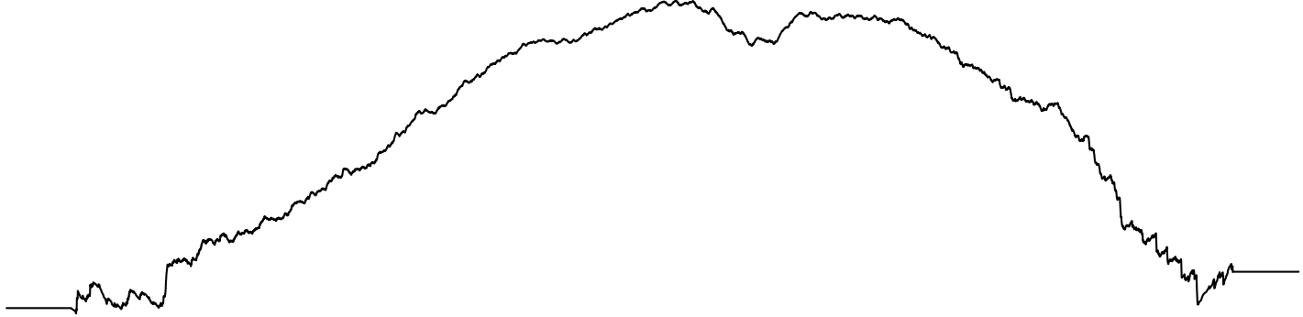
ClaSP - Classification Score Profile
Plot scores for all splits
Insight: Score is highest, if a split produces regions with distinguishable properties
This corresponds to changes in the underlying state

Slide 15
ClaSP - Pipeline and Design Options
Extract subsequences of length w
Determine Window Size w
Time Series of length n
Create n binary classification problems, (one for each split)
fit and evaluate Classifier on each split
Classifier:
k-NN ED
Classification Score Profile
Scoring Function:
ROC / AUC
Segmentation (local Maxima)
Peak Finder:
Recursive Splitting

Slide 16
k-NN Classifier - Relabelling
Training of n classifiers can be inefficient
A trick with k-NN avoids re-training each split
We train the k-NN with Euclidean distance once
Only apply relabelling to each split in O(n)
First compute NNs of each subsequence
NN
NN
Offset in
Time Series
1 2
3 4
NN
NN
NNs
2 1
4 3

Slide 17
k-NN Classifier – Relabelling
Iterate and relabel splits
Split labels change but NN offsets don’t
1. split
Offset
1 2
3 4
NN offsets
2 1
4 3
NN
NN
NN points to current prediction
Split y_{true}
0 1
1 1
NN y_{pred}

Slide 18
k-NN Classifier - Relabelling
Iterate and relabel splits
Split labels change but NN offsets don’t
1. split
Offset
1 2
3 4
NN offsets
2 1
4 3
NN
NN
NN points to current prediction
Split y_{true}
0 1
1 1
y_{pred}
y_{pred}
NN y_{pred}
1 0
1 1
Score=50%

Slide 19
k-NN Classifier - Relabelling
Iterate and relabel splits
Split labels change but NN offsets don’t
2. split
Offset
1 2
3 4
NN offsets
2 1
4 3
NN
NN
NN points to current prediction
Split y_{true}
0 0
1 1
y_{pred}
y_{pred}
NN y_{pred}
0 0
1 1
Score=100%

Slide 20
k-NN Classifier - Relabelling
Iterate and relabel splits
Split labels change but NN offsets don’t
3. split
Offset
0 1
2 3
NN offsets
1 0
3 2
NN
NN
NN points to current prediction
Split y_{true}
0 0
0 1
y_{pred}
y_{pred}
NN y_{pred}
0 0
1 0
Score=50%

Slide 21
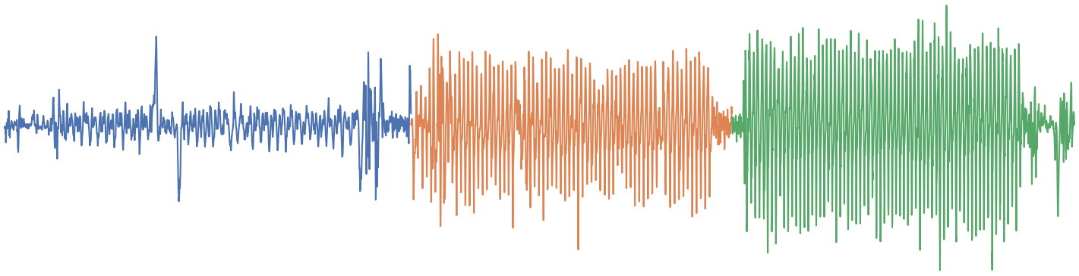
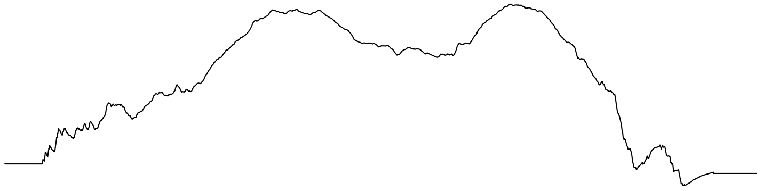
Peak Finder – Recursive Splitting – Non-Binary Splits
walk
jog
run
Compute global ClaSP
global maximum = First Split
21

Slide 22
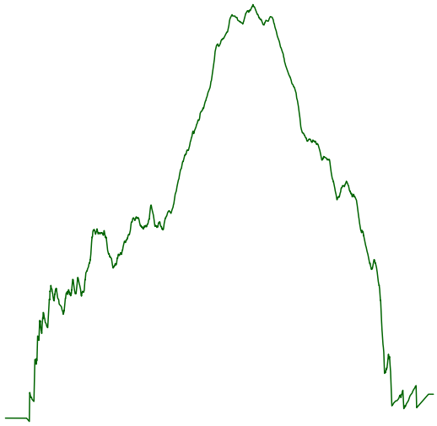
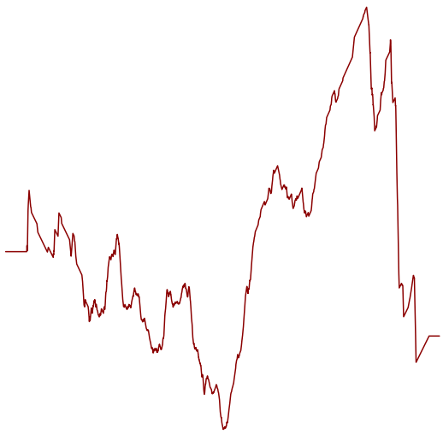
Peak Finder – Recursive Splitting – Non-Binary Splits
walk
jog
run
choose maximum
= Second Split
Compute Right ClaSP
Compute Left ClaSP
22

Slide 23
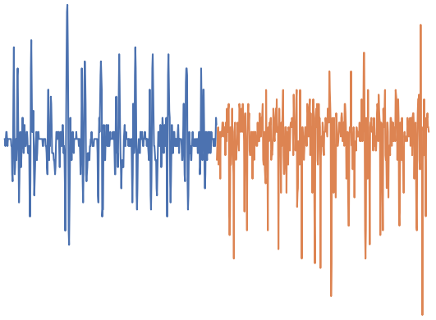
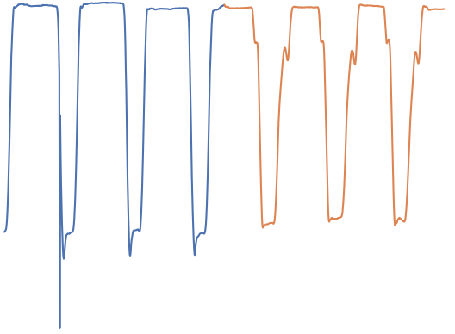
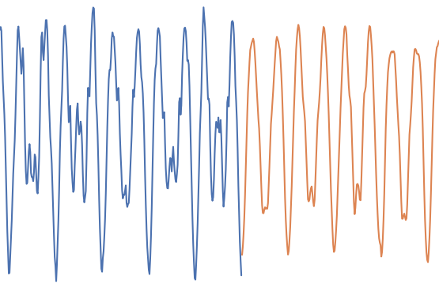
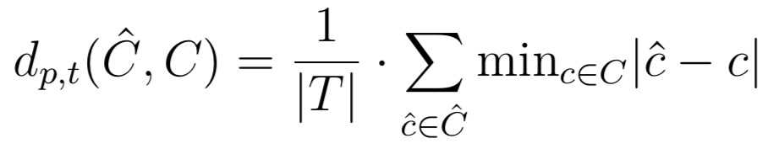
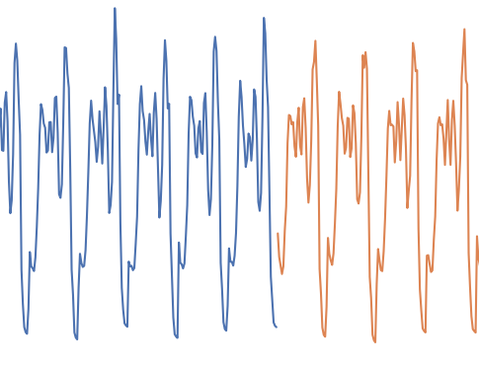
Benchmark Datasets
32 Segmentation DS [3]
1-2 change points
annotated by human experts
66 semi-synthetic UCR archive [4]
1-6 change points
group & concatenate by same label
annotated by design
Metric: relative difference between predicted and true change points [3]
walking
playing
no gun
gun
Avonlea
Clovis
Robusta
Arabica

Slide 24
Ablation Study: Scoring Metric and Parameters
3-NN and ROC-AUC performed best
(avoids class imbalances and noise)

Slide 25
Ablation Study: Window Size
No window selection is as good as expert annotations (ClaSP) but mean ensembling comes close
We use expert annotations for all methods in the following experiments

Slide 26
Comparative Analysis
ClaSP is significantly better than is competitors on binary (CP=1) and non-binary (CP>1) segmentation

Slide 27
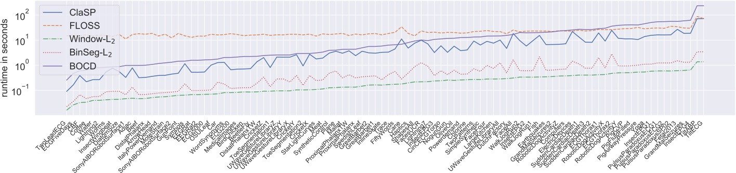
Runtime
ClaSP is faster than the second best method FLOSS

Slide 28
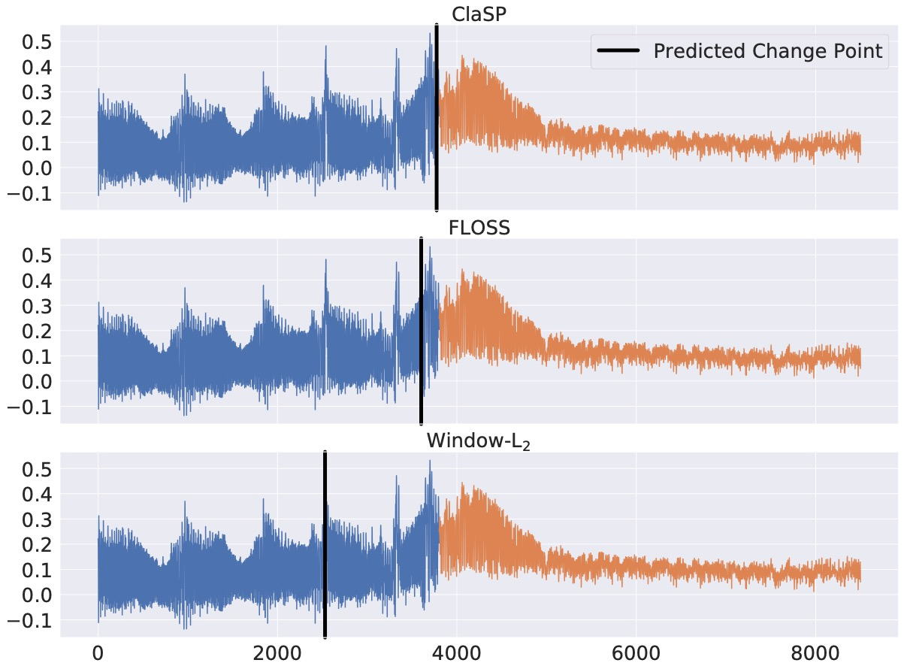
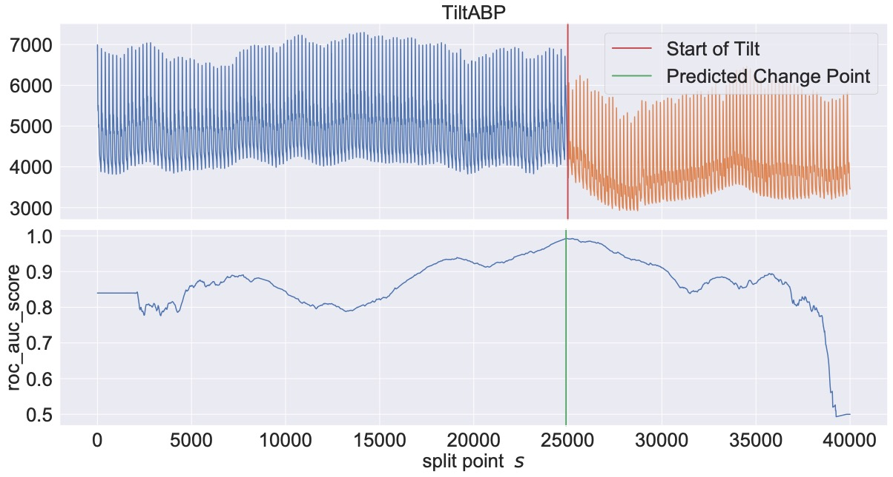
Real-World Use-Cases – Please refer to our Paper
Please see the paper

Slide 29
Summary
ClaSP is a novel algorithm for segmentation based on self-supervision and classification
ClaSP produces and analyses a classification score profile
Local maxima indicate state changes in the underlying process
The profile is thus interpretable
Our experimental evaluation shows that
ClaSP sets the new state-of-the art on the benchmark sets
And is faster than the second best competitor
ClaSP may be extended for more powerful classifiers and features extraction techniques in future work

Slide 30
References
Greenwald, S. D. (1986). The development and analysis of a ventricular fibrillation detector. Doctoral dissertation.
Banos, O., Toth, M. A., Damas, M. et al. (2014). Dealing with the effects of sensor displacement in wearable activity recognition.
Gharghabi, S., Yeh, Keogh, E. et al. (2019). Domain agnostic online semantic segmentation for multi-dimensional time series.
Dau, H. A., Bagnall, A., Kamgar, K. (2019). The UCR time series archive. IEEE/CAA Journal of Automatica Sinica.

Slide 31
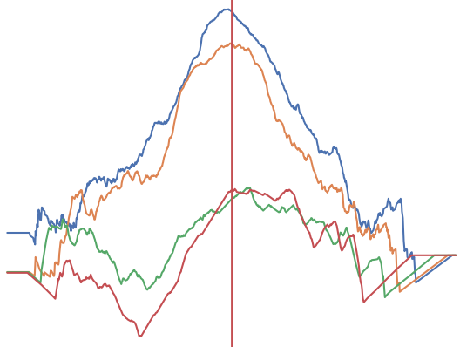
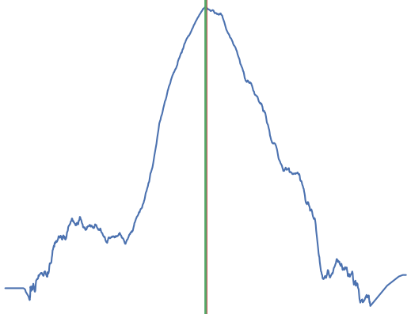
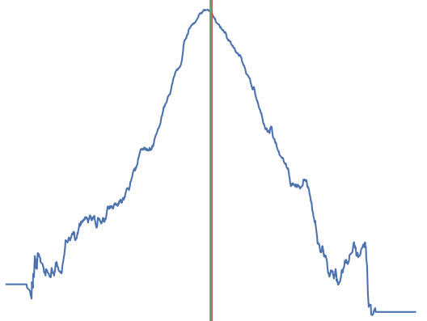
Determine Window Size
true change point
mean
true / predicted
change points
max
Aggregate ClaSP curves over multiple lengths
Use dominant Fourier Frequency
Use Domain-Expert Labels

Slide 32
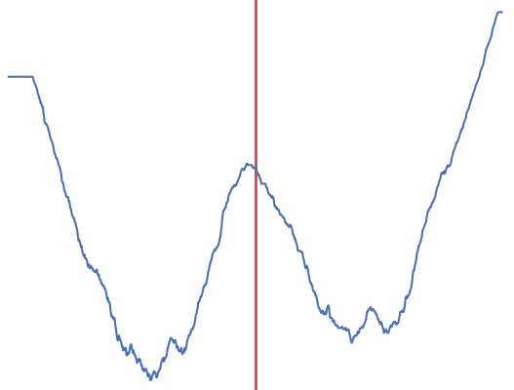
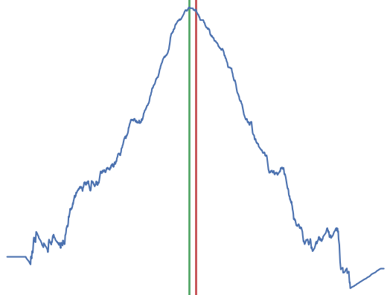
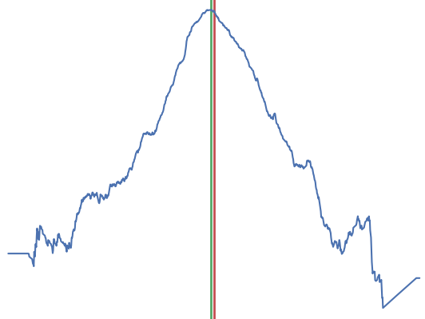
Choice of Scoring Metrics
We have a high class imbalance.
1. accuracy
High scores to the corners
predicted change point
true change point
2. f1
3. roc/auc
best results

